Slide 1
WCS
How to get waste to WCS
Texas Compact Commission Workshop
12/13/2024

Slide 2
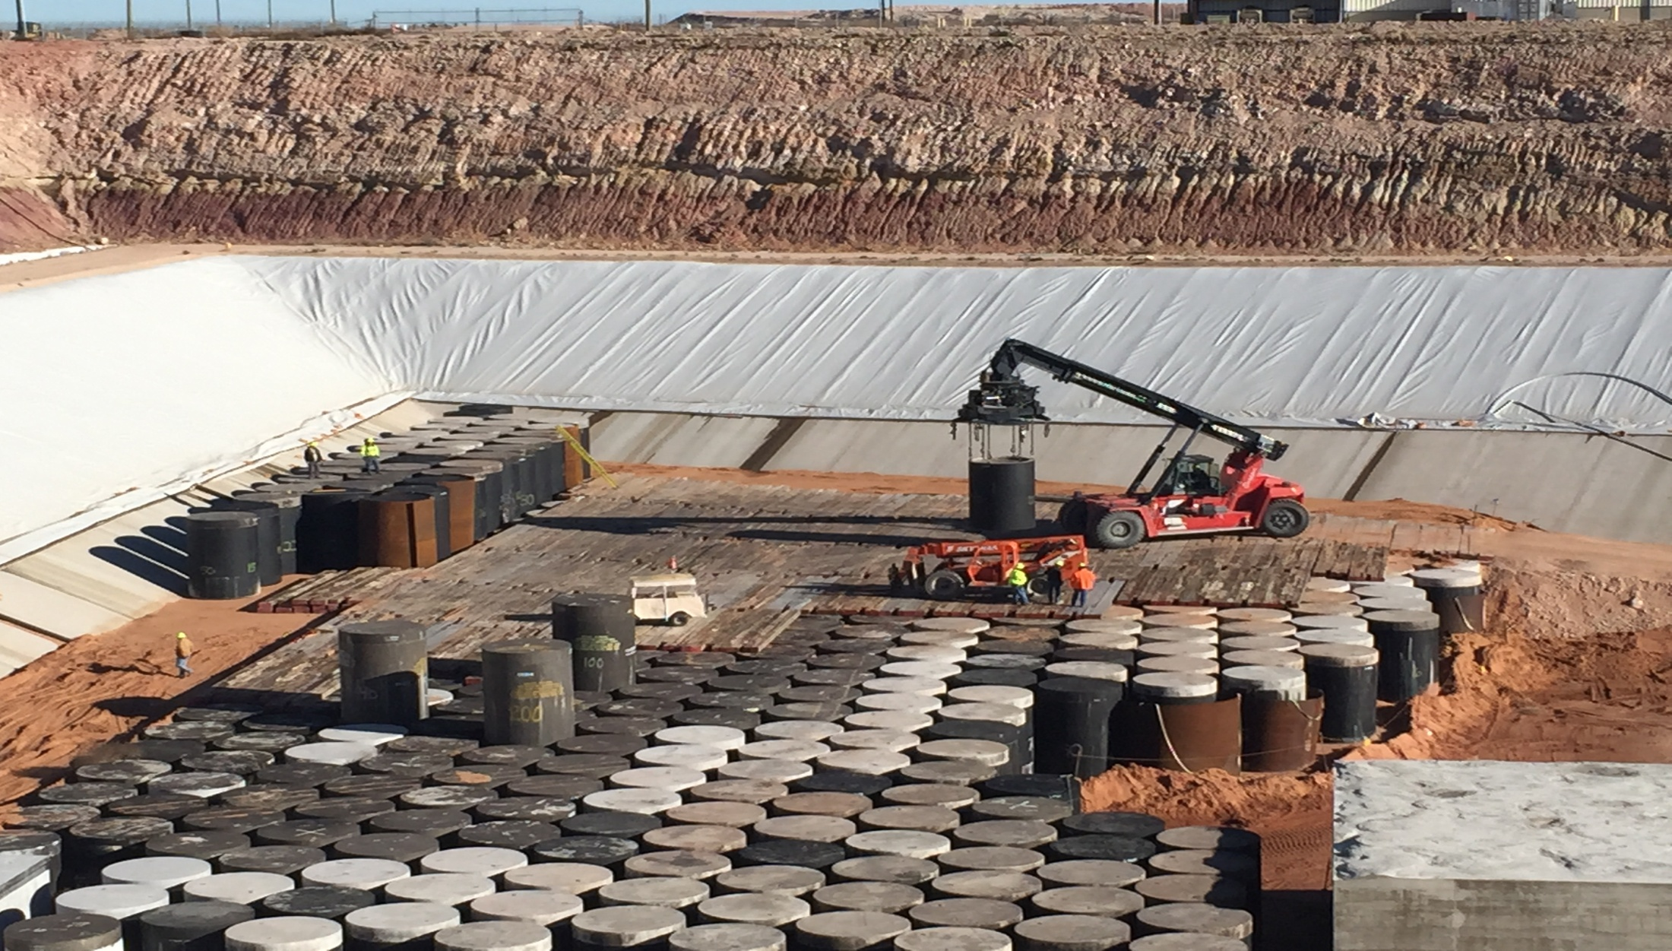
Compact Waste Facility
Importation Applies

Slide 3
Importing Waste into the CWF
All importation of waste into the Texas Low-Level Radioactive waste Compact shall be done in compliance with 31 TAC §675.23 “Importation of Waste from a Non-Party Generator for Disposal”.
  All Import Applications must be publicly posted for a minimum of 35 days but not more than 100 days before the commission can act on it
  A minor amendment must be publicly posted for a minimum of 15 days before the commission can act on it.
All Import Applications should be electronically submitted via the commission’s website.
  www.tllrwcc.org/importation-form/
Notes:
Verbally walk through the application and amendment process.

Slide 4
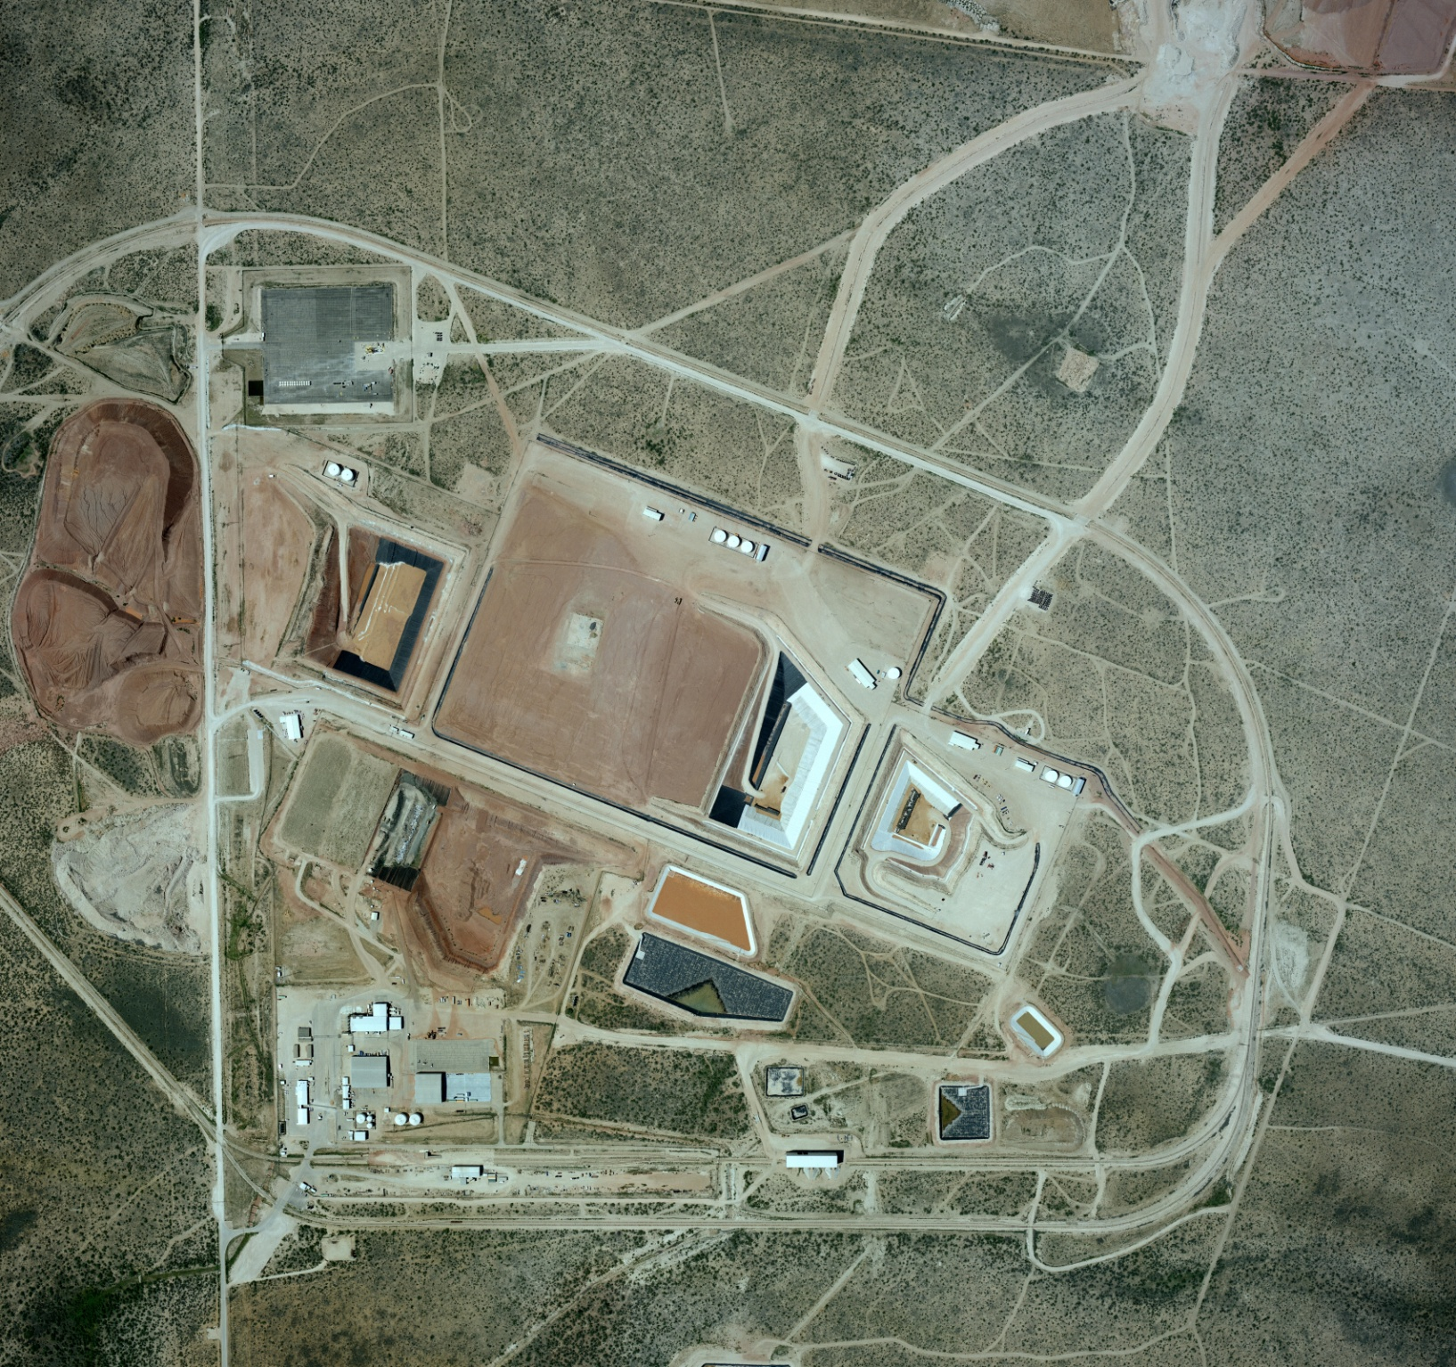
WCS Facilities
LSA PAD
By-product
Federal Waste Facility
RCRA Subtitle C
Landfill
Compact Waste Facility
TSDF Facility and Admin Buildings

Slide 5
Important Import Agreements Definitions
Generator - The term "generator" means a person who produces or processes low-level radioactive waste in the course of its activities, excluding persons who arrange for the collection, transportation, management, treatment, storage, or disposal of waste generated outside the party states, unless approved by the Commission.
Broker - A waste broker, waste processor, initial distributor, other distributor, decontamination service provider, or licensed manufacturer of sealed sources or devices who received radioactive materials from a customer before April 27, 2012, may complete TCEQ Form 20225 as the generator of that waste if it provides adequate documentation that the waste is not of international origin. Such waste may only be disposed of in the Compact Facility as party-state (in-compact) waste if the entity acting as the generator of the waste provides adequate documentation that the waste is from Texas or Vermont. If the entity acting as the generator of the waste cannot adequately document that the waste is from Texas or Vermont, the waste will be treated as non-party-state (out-of-compact) waste and will require import authorization in accordance with §675.23 of this title (relating to Importation of Waste from a Non-Party Generator for Disposal). To provide the documentation described in this subparagraph, the entity acting as the generator of the waste may rely on various records, including, but not limited to, source/device leak tests, source/device inventories, transfer/receipt records, transportation manifests, purchasing records, or other records determined by the Commission to be suitable as documentation regarding the origin of the waste.
SQG - A "small quantity generator" is a generator of low-level radioactive waste that generates no more than 200 cubic feet or no more than 100 curies of such waste per year, and does not include nuclear power generation facilities, electric utilities, or the United States Department of Defense.

Slide 6
Important aspects of the IA
Section (J)
    Waste Volume in (Cubic feet)
    Waste radioactivity in (Curies)
    Place of origination (State or U.S. Territory)
    Waste Description
    Waste Classification (Class A, B or C)
    Waste Form
    Sealed Sources

Slide 7
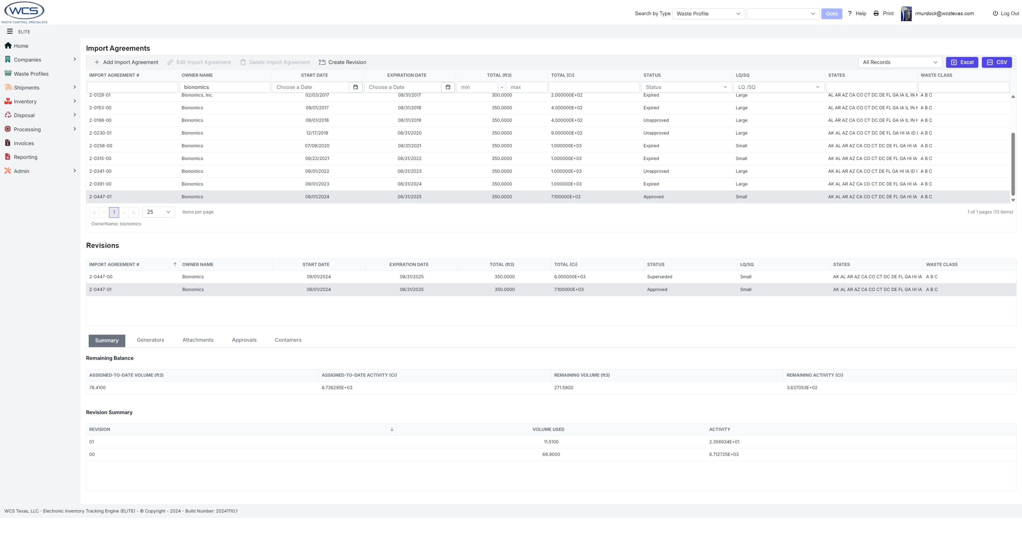
WCS Tracking of Generator IA volume and conditions
Expiration Date; 8/31/2025 | Agreement # | Approved Curies | Approved Cubic Feet
Bionomics Inc | 2-0447-01 | 7,100.0 | 350.0
Manifest number | Total Activity (mCi) | Total Activity (Ci) | Total Volume (ft³) | Verified with final shipping document (initial/date)
BW-09-24 | 1.60E+04 | 15.98 | 15.0 | LT 10/10/2024 | CRL #1
BW-12-24 | 6.70E+06 | 6,696.70 | 51.9 |  | CRL # 2
BW-15-24 | 2.36E+04 | 23.57 | 11.5 |  | CRL # 2
 |  | 0.00
 |  | 0.00
 |  | 0.00
 |  | 0.00
 |  | 0.00
 |  | 0.00
 |  | 0.00
 |  | 0.00
 |  | 0.00
 |  | 0.00
 |  | 0.00
 |  | 0.00
 |  | 0.00
 |  | 0.00
 |  | 0.00
 |  | 0.00
 |  | 0.00
Total for all shipments |  | 6,736.25 | 78.41
Available Inventory |  | 363.75 | 271.59
% used |  | 94.88% | 22.40%

Slide 8
WCS WAC in relation to IA’s
The Waste Acceptance Criteria is located in Appendix C of the Radioactive Material. Current License is RML4100 amendment 40.
Section 3 Limitations and Prohibited Wastes
Section 4 Waste Types or Streams
Section 5 Waste Generator Audit/Certification
Section 6 Waste Classification
Section 7 Waste Characterization
Section 10 Waste Form and Packaging Requirements
Section 12 Transportation

Slide 9
Important aspects of the IA
For generator(s) and or Brokers in section (j) you could have stipulations on conditions for which you could need additional information in the form of a Curie Release Letter or a Conditional Removal Letter prior to shipment.
Curie Release letters are required for any IA asking for more that 15,000 curies in an IA year.
Conditional removal letter is required for waste that is being exported out of certain compacts or territories within the IA year.

Slide 10
Overview Waste Process
Initial Customer Contact (w/existing contract)
Initial Customer Contact (w/o existing contract)
Generator Certification (CWF/FWF)
Waste Profile Approval
TLLRWCC Import Approval (if applicable)
Waste Shipment Request Approval
Final Paperwork Verification
Waste Acceptance Upon Receipt by WCS and TCEQ
Waste Approval for Disposal

Slide 11
Initial Customer Contact with Existing Contract
Customer contacts their BD rep to arrange the shipment as well as any support needs (i.e.; cask transport, sealand/other packaging needs, etc.).
BD works with specific group(s) to coordinate shipment dates and any support needs (e.g.; Technical Services, Transportation, etc.)
Customer submits required documents (i.e.; Waste Profile, Shipping Request, Draft manifest, etc.).
BD reviews pricing and the Technical Services and Waste Acceptance groups review and approve the Waste Profile, if required.
Technical Services works with customer to submit a Shipping Request which is also approved by TS and WA.
Waste Acceptance confirms that the Import Agreement has sufficient volume and curies available to accept shipment if going to the CWF.

Slide 12
Initial Customer Contact without a Contract
Typically, BD receives requests to ship waste to WCS through our website or through others familiar with WCS’s capabilities.
BD works with its management and Site Mgrs. to develop pricing and Contracts to develop a contract based on the customer’s needs that is then sent to the customer to review. Once agreed upon, both parties sign the Contract.
For CWF waste, WCS submits the contract to TCEQ along with several required forms so the contract can be reviewed and approved. This process typically takes 5 working days to complete.
The customer then submits an Import Application for CWF wastes for approval by the Texas Compact Commission. The TCC typically meets every other month to approve the IA’s or amendments to IA’s.
The customer then submits a Dept. of State Health Services (DSHS) registration request and QA performs a Generator Certification to confirm the generator has the appropriate procedures and programs in place.
The other submittals/ (i.e.; Waste Profile, Shipping Request, etc.) are then submitted as noted on the prior slide.

Slide 13

Generator Certification
Waste generators are responsible for ensuring their waste management program satisfies the WCS Waste Acceptance Plan (WAP) requirements. This process includes such steps as annually verifying:
  Generator has a process for waste characterization
  Waste sampling process
  Regulatory compliance
  QA Program meets required criterion
  Container inspections
  Applicable training programs
  Waste packaging and sampling program
  Waste shipper qualifications
  Waste classification procedures/programs
  Copy of generator radioactive material license
  Relevant compliance history
  External audit reports/NRC inspection reports

Slide 14
Waste Profile Approval
A waste profile must be submitted and approved through the WCS waste tracking software.
A waste profile includes an overview of the waste stream and its physical, chemical, and radiological characteristics.
A waste profile and supporting documentation must demonstrate reasonable assurance that the waste is correctly classified as Class A, B or C in accordance with 30 TAC §336.362, Appendix E.
The documentation must include the methodology and basis for methodology used to classify/characterize the waste. As well as demonstrate the basis is adequate and appropriate.

Slide 15
Waste Profile Approval

Slide 16
TLLRWCC Import Approval
A generator outside of the Texas Low Level Radioactive Waste Compact must submit an import petition for approval to the Texas Low Level Radioactive Waste Compact Commission (TLLRWCC) prior to shipping waste to the WCS CWF.
The import petition includes
  Generator Name and address
  Contact
  Generator or Broker
  Generator Type
  Small/Large Quantity generator
  Fiscal year
  Waste Volume (ft3)
  Waste Activity (curies)
  Waste Class (A,B,C)
  Waste Form

Slide 17
TLLRWCC Import Approval (as applicable)
  Compact and/or unaﬃliated state, territory, possession, or district of the United States where the waste was generated
  Waste Description
  Does Applicant have any unresolved violation(s), complaint(s), unpaid fee(s), or past due report(s) with the Texas Low-Level Radioactive Waste Disposal Compact Committee
  Does Applicant have any unresolved violation(s), complaint(s), unpaid fee(s), or past due reports
  associated with radioactive waste receipt, storage, handling, management, processing, or transportation pending with any other regulatory agency with jurisdiction to regulate radioactive material including, without limitation, the Texas Commission on Environmental Quality (TCEQ)?

Slide 18
Waste Shipment Request Approval
The process for approving a waste shipment request includes steps such as:
  Verify active waste profile is on file for subject waste generator and that they are a certified generator if applicable
  Approval of shipment type and receiving facility
  Review of advance waste manifest to ensure compliance with profile
  Confirm current import agreement is in place and adequate for shipment request volumes and curies, where applicable
  Verify WCS is an authorized cask user, where applicable
  Request transporter’s certificate of insurance
  Confirm waste meets WAP/WAC as well as the RML and permits
  Communicate with appropriate WCS personnel regarding timing of shipment and waste makeup
  Establish delivery schedule
  Send shipment approval form to customer

Slide 19
Final Paperwork Verification
Prior to shipment a final paperwork verification is performed to include:
  Final manifest documents are reviewed to determine if changes were made from advance manifest
  Obtain driver(s) name as it appears on their CDL and cell phone number.
  Obtain pre-shipment departure radiological survey of vehicle and waste containers

Slide 20
Waste Acceptance Upon Receipt
When waste shipment arrives at WCS verification steps include:
  Waste was shipped under an active waste profile
  Shipment was authorized by WCS
  Radiological Surveys are performed on vehicle and waste packages
  Number of waste packages matches manifest
  Each radionuclide and activity are listed on shipping document and is consistent with waste profile
  Verify waste package integrity
  Ensure waste packages are properly marked and labeled
TCEQ Resident Inspectors also perform their own inspections upon arrival at WCS(CWF/FWF)

Slide 21
Waste Approval for Disposal
Once waste is accepted the waste package is placed into a Modular Concrete Canister (MCC) and grout or sand (as applicable) is used to fill any remaining void in the MCC
Any residual liquid, if present, in the waste package is solidified prior to disposal in the CWF

Slide 22
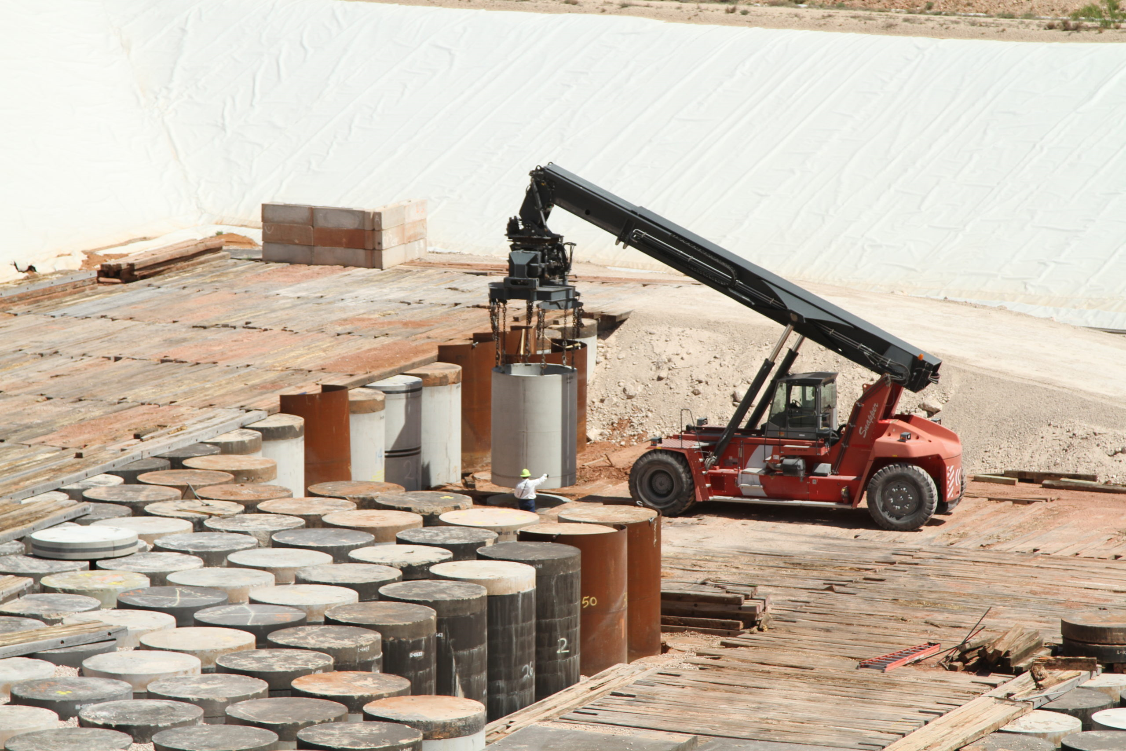
Waste Disposal in CWF/FWF/RCRA Cells

