Slide 1



WCS Andrews Update
Texas Compact Commission Workshop
10/08/2026

Slide 2
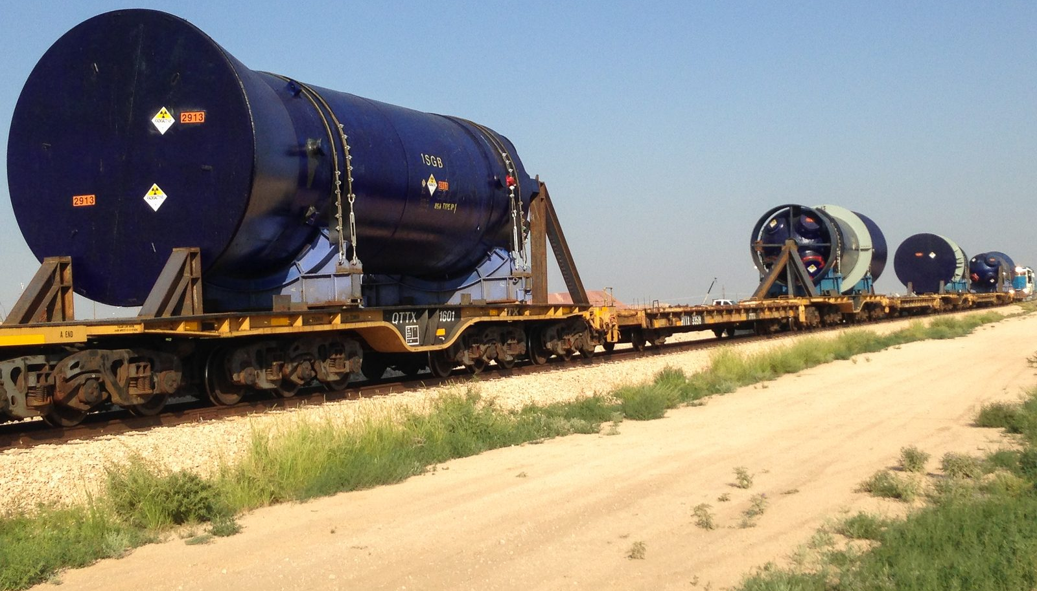
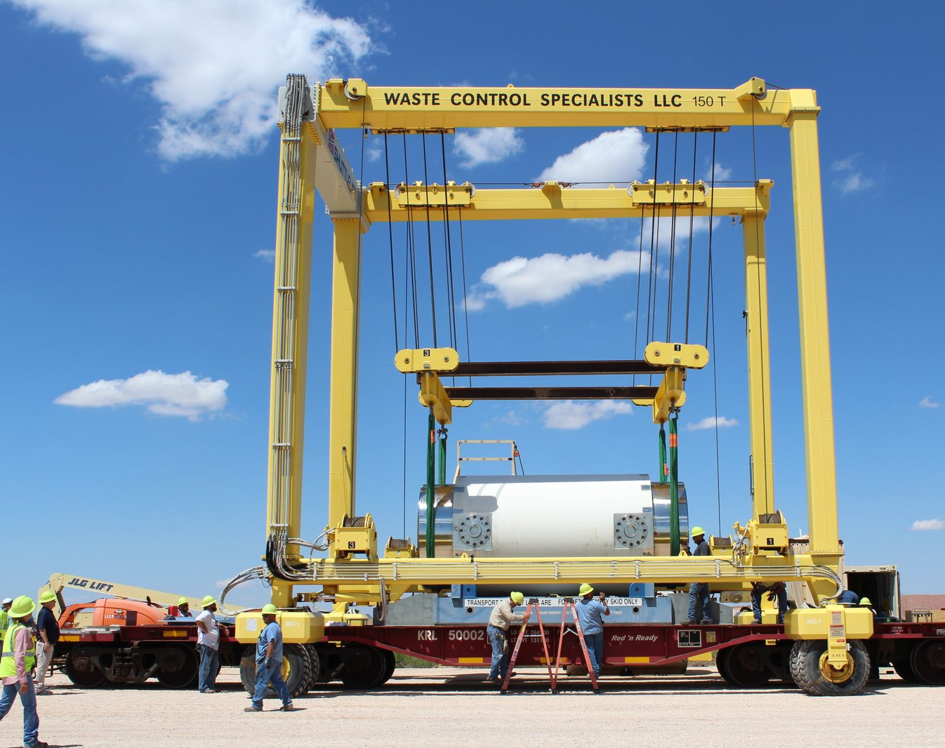
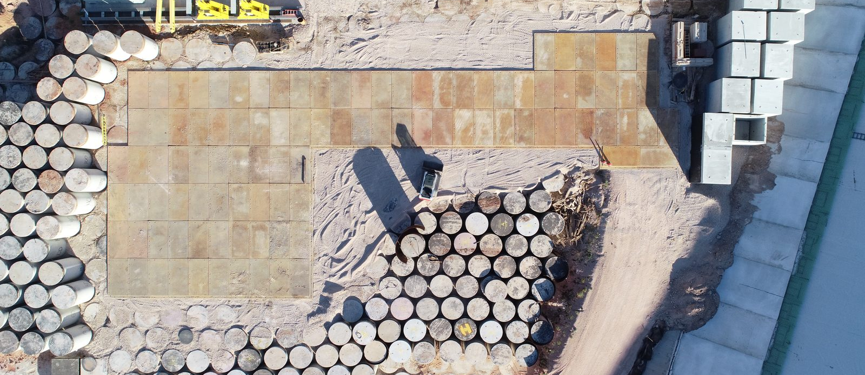
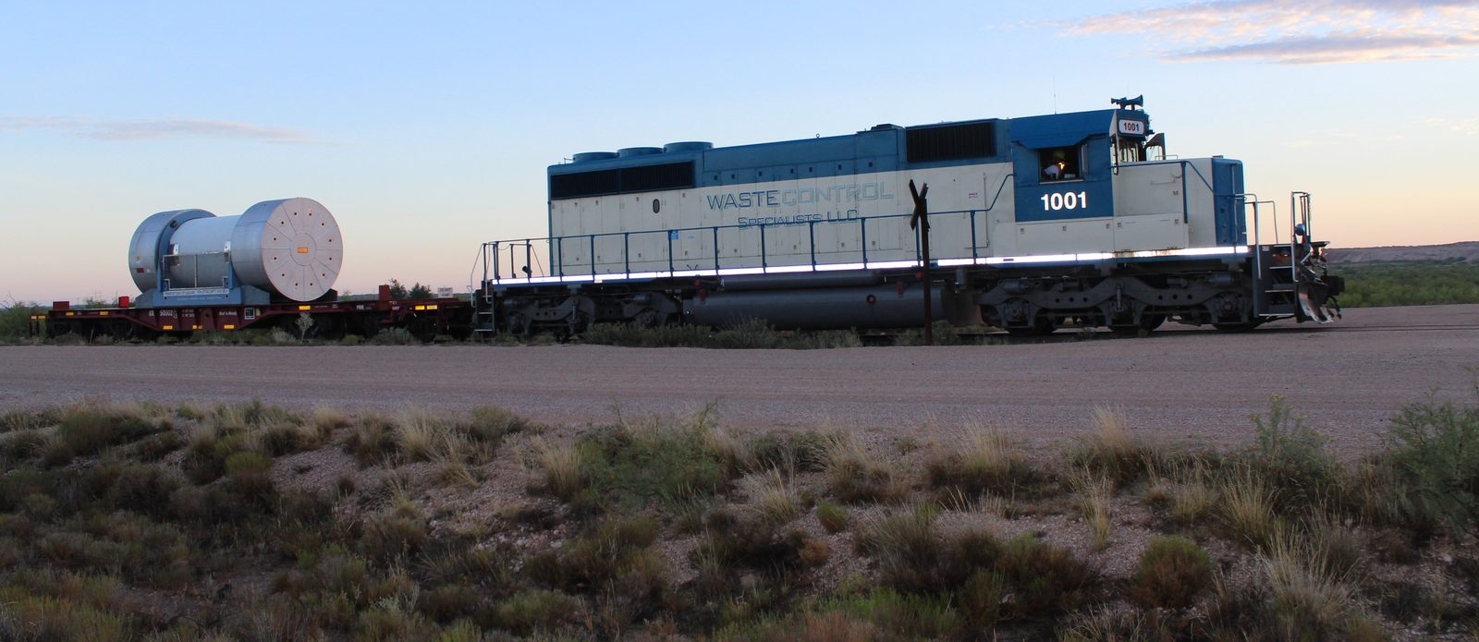
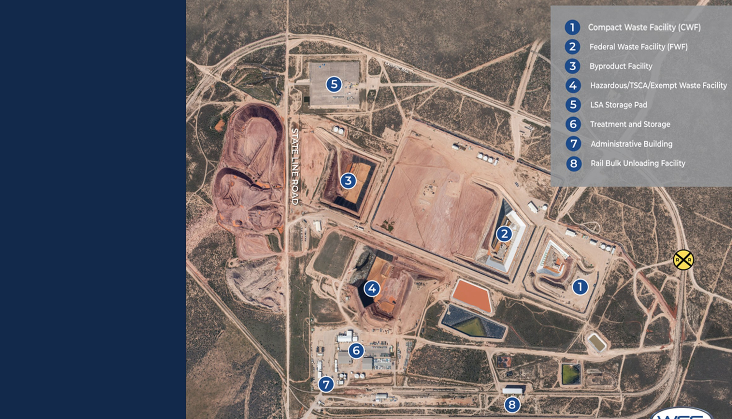

Slide 3
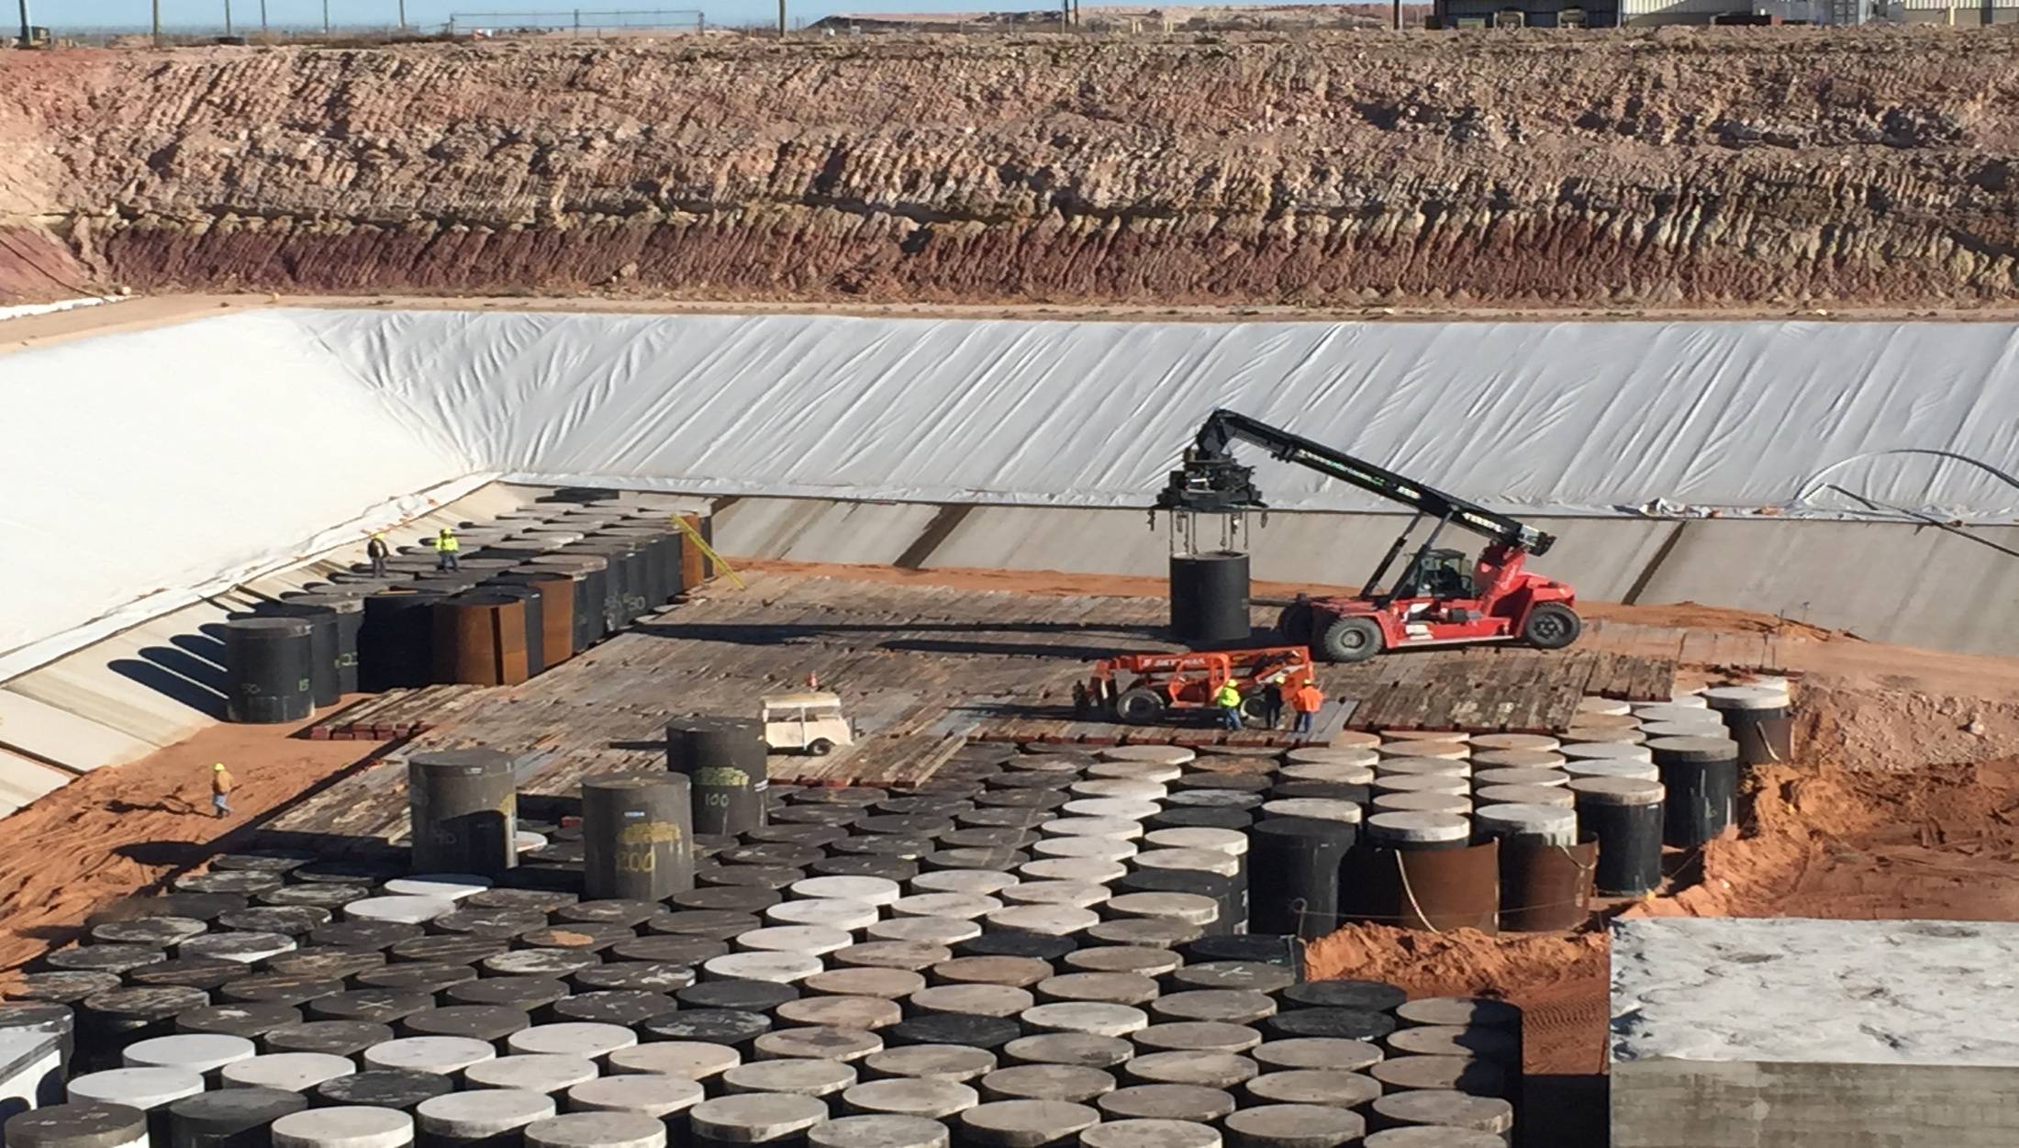
Compact Waste Facility (CWF)
Importation Applies
3

Slide 4
Importing Waste into the CWF
All importation of waste into the Texas Low-Level Radioactive Waste Disposal Compact shall be done in compliance with 31 TAC §675.23 “Importation of Waste from a Non-Party Generator for Disposal”.
The commission acts on an Import Application no earlier than 35 days after it is posted and no later than 100 days after it is received
The Chair or delegate may act on a minor amendment no earlier than the 15th calendar day after it is posted.
All Import Applications should be electronically submitted via the commission’s website.
www.tllrwdcc.org/importation-form/
4

Slide 5
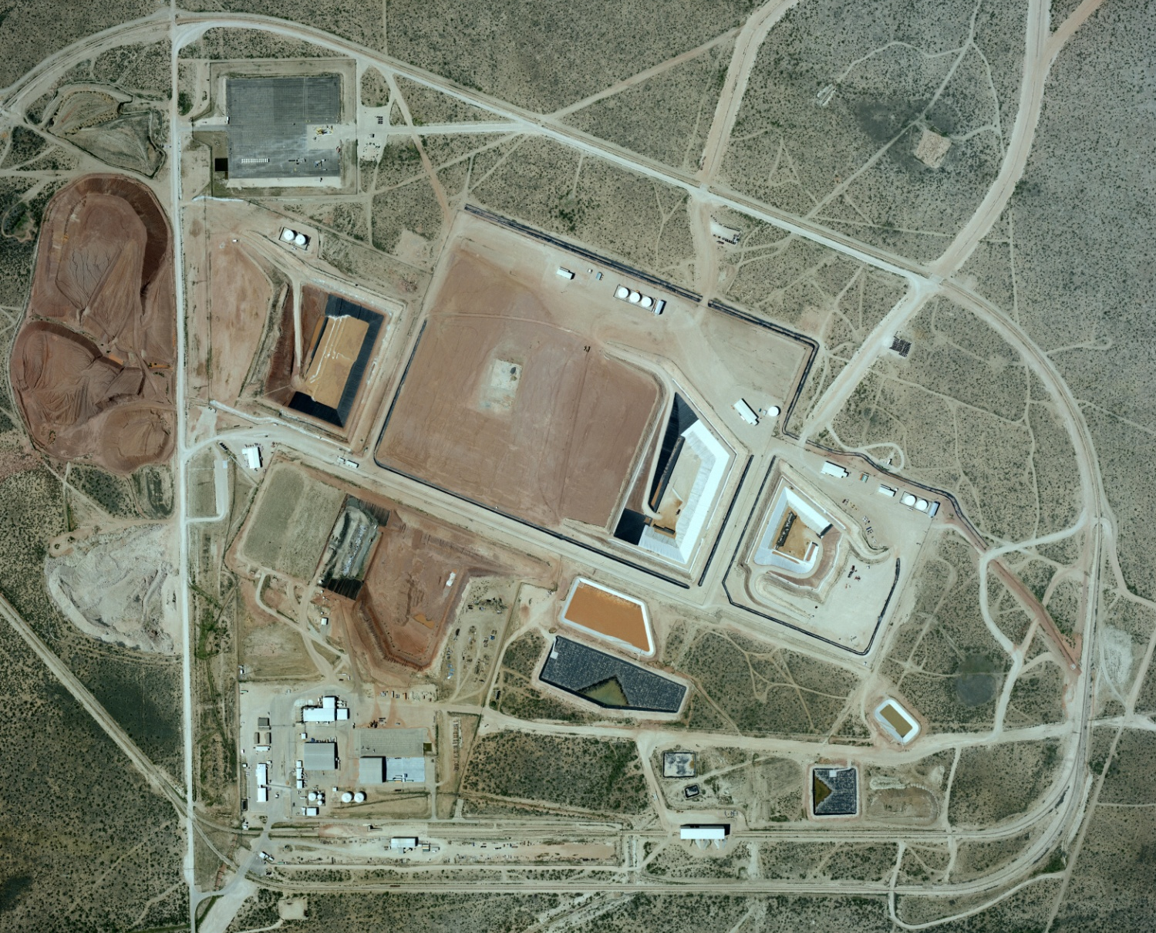
WCS Andrews Facilities
LSA PAD
By-product
Federal Waste
Facility
RCRA Subtitle C
Landfill
Compact Waste
Facility
TSDF Facility and Admin Buildings
5

Slide 6
Important Import Agreements Definitions
Generator - The term "generator" means a person who produces or processes low-level radioactive waste in the course of its activities, excluding persons who arrange for the collection, transportation, management, treatment, storage, or disposal of waste generated outside the party states, unless approved by the Commission.
Broker - A waste broker, waste processor, initial distributor, other distributor, decontamination service provider, or licensed manufacturer of sealed sources or devices who received radioactive materials from a customer before April 27, 2012 may complete TCEQ Form 20225 as the generator of that waste if it provides adequate documentation that the waste is not of international origin. Such waste may only be disposed of in the Compact Facility as party-state (in-compact) waste if the entity acting as the generator of the waste provides adequate documentation that the waste is from Texas or Vermont. If the entity acting as the generator of the waste cannot adequately document that the waste is from Texas or Vermont, the waste will be treated as non-party-state (out-of-compact) waste and will require import authorization in accordance with §675.23 of this title (relating to Importation of Waste from a Non-Party Generator for Disposal). To provide the documentation described in this subparagraph, the entity acting as the generator of the waste may rely on various records, including, but not limited to, source/device leak tests, source/device inventories, transfer/receipt records, transportation manifests, purchasing records, or other records determined by the Commission to be suitable as documentation regarding the origin of the waste.
SQG - A "small quantity generator" is a generator of low-level radioactive waste that generates no more than 200 cubic feet or no more than 100 curies of such waste per year, and does not include nuclear power generation facilities, electric utilities, or the United States Department of Defense
6

Slide 7
Important Aspects of the IA
Section (IV) of online form
Application Basics
Location and Compliance
Additional Conditions,
if applicable
Generator name and contact
Place of origin
Curie Release Letter
Generator or broker
Current location of waste
Conditional Removal Letter
Waste volume and radioactivity
Compliance history
(violations, fees, reports)
Shipment limits for
brokers and processors
Waste class, form, and description
7

Slide 8
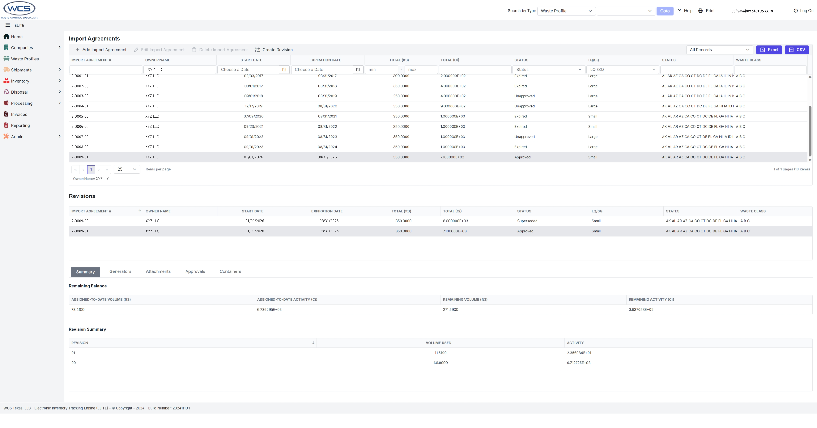
WCS Tracking of Generator IA Volume and Conditions
Start Date: 9/1/2025 | Agreement # | Approved Curies | Approved Cubic Feet
Expiration Date: 8/31/2026
XYZ LLC | 2-0009-01 | 8,500.00 | 500
Manifest number | Total Activity (mCi) | Total Activity (Ci) | Total Volume (ft³) | Verified with final shipping document (initial/date)
XYZ-03-26 | 1.60E+05 | 160.00 | 50 | AG 03/16/2026 | CRL # 1
XYZ-05-26 | 6.70E+06 | 6,700.00 | 100 | AR 05/04/2026 | CRL # 2
XYZ-08-26 | 2.36E+05 | 236.00 | 50 | AG 08/10/2026 | CRL # 3
 |  | 0 | 0
 |  | 0 | 0
 |  | 0 | 0
 |  | 0 | 0
 |  | 0 | 0
 |  | 0 | 0
 |  | 0 | 0
 |  | 0 | 0
 |  | 0 | 0
Total for all shipments |  | 7,096.00 | 200.00
Available Inventory |  | 1,404.00 | 300.00
% used |  | 83.48% | 40.00%
8

Slide 9
WCS WAC in Relation to IAs
WCS’s Waste Acceptance Criteria are located in Appendix C of the Radioactive Material License R04100.
  Section 3 Limitations and Prohibited Wastes
  Section 4 Waste Types or Streams
  Section 5 Waste Generator Audit/Certification
  Section 6 Waste Classification
  Section 7 Waste Characterization
  Section 10 Waste Form and Packaging Requirements
  Section 12 Transportation
9

Slide 10
Important Aspects of the IA
For Generator(s) and/or Brokers in section IV of the online form you could have stipulations on conditions for which you could need additional information in the form of a Curie Release Letter or a Conditional Removal Letter prior to shipment.
Curie Release Letters are required for any IA asking for more than 15,000 curies in an IA year.
Conditional Removal Letter is required for waste that is being exported out of certain compacts or territories.
10

Slide 11
Overview Waste Process
Initial Client
Contact
Generator
Certification
Waste Profile
Approval
Import Approval,
if applicable
Shipment Request
Approval
Final Paperwork
Verification
Acceptance at Receipt
(WCS and TCEQ)
Waste Approval
for Disposal
11

Slide 12
Who Does What in the Process
Generator / Broker
Initial Client
Contact
Execute
Contract
File Import
Application,
if applicable
Register with
Texas DSHS
Submit Waste
Profile and
Shipping Request
TCEQ
Review
Contract (about
5 working days)
Resident
Inspector
Checks at Receipt
Texas Low-Level Radioactive Waste Disposal Compact Commission
Public Posting
(minimum
35 days)
Commission
Action
WCS
Generator
Certification
Waste Profile
Approval
Shipment
Request
Approval
Final
Paperwork
Verification
Acceptance
at Receipt
Waste Approval
for Disposal
12

Slide 13
Initial Client Contact with Existing Contract
Client contacts their BD rep to arrange the shipment as well as any support needs (e.g., cask transport, sealand/other packaging needs, etc.).
BD works with specific group(s) to coordinate shipment dates and any support needs (e.g., Technical Services, Transportation, etc.)
Client submits required documents (e.g., Waste Profile, Shipping Request, Draft manifest, etc.).
BD reviews pricing and the Technical Services and Waste Acceptance groups review and approve the Waste Profile and Shipping Request as required.
Technical Services confirms that the Import Agreement has sufficient volume and curies available and if the required Conditional Removal Letter or Curie Release Letter is in place as applicable to accept the shipment if the shipment is going to the CWF.
13

Slide 14
Initial Client Contact without a Contract
Most requests to send waste to WCS come to our business development team through our website or from people who already know what WCS can do.
Our business development team works with managers, site leads, and the pricing and contracts teams to build a contract that fits what the client needs. The client reviews it, and once everyone agrees, both sides sign it.
For CWF waste, WCS sends the contract and the required forms to the Texas Commission on Environmental Quality (TCEQ) for review and approval. This usually takes about 5 working days.
The client then files an Import Application for CWF waste, which the Texas Compact Commission must approve. The commission usually meets every other month to approve new applications or changes to existing ones.
The client also files a registration request with the Texas Department of State Health Services (DSHS). Our quality assurance team completes a Generator Certification to confirm the site sending the waste has the right procedures and programs in place.
The remaining paperwork, such as the waste profile and shipping request, is submitted as described on the previous slide.
14

Slide 15

Generator Certification
Waste generators are responsible for ensuring their waste management program satisfies the WCS Waste Acceptance Plan (WAP) requirements. This process includes such steps as annually verifying:
Generator has a process for waste characterization
Waste sampling process
Regulatory compliance
QA Program meets required criteria
Container inspections
Applicable training programs
Waste packaging and sampling program
Waste shipper qualifications
Waste classification procedures/programs
Copy of generator radioactive material license
Relevant compliance history
External audit reports/NRC inspection reports
15

Slide 16
Waste Profile Approval
Clients must submit a waste profile through the WCS waste tracking system and receive approval before shipping.
The profile describes the waste stream and its physical, chemical, and radiological characteristics.
Together with its supporting documentation, the profile must provide reasonable assurance that the waste is correctly classified as Class A, B, or C under 30 TAC §336.362, Appendix E.
The documentation must also explain the methodology used to classify and characterize the waste, and show that the basis for that methodology is adequate and appropriate.
16

Slide 17
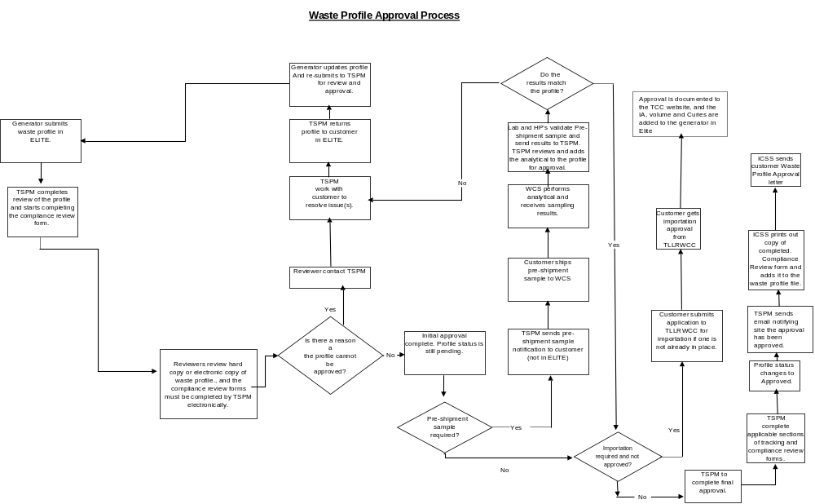
Waste Profile Approval Process
17

Slide 18
TLLRWDCC Import Approval
A generator outside of the Texas Low-Level Radioactive Waste Disposal Compact must submit an import petition for approval to the Texas Low-Level Radioactive Waste Disposal Compact Commission (TLLRWDCC) prior to shipping waste to the WCS CWF.
The import petition includes
Generator Name and address
Contact
Generator or Broker
Generator Type
Small/Large Quantity generator
Fiscal year
Waste Volume (ft³)
Waste Activity (curies)
Waste Class (A, B, C)
Waste Form
18

Slide 19
TLLRWDCC Import Approval (as applicable)
Compact and/or unaffiliated state, territory, possession, or district of the United States where the waste was generated
Waste Description
Does Applicant have any unresolved violation(s), complaint(s), unpaid fee(s), or past due report(s) with the Texas Low-Level Radioactive Waste Disposal Compact Commission
Does Applicant have any unresolved violation(s), complaint(s), unpaid fee(s), or past due reports associated with radioactive waste receipt, storage, handling, management, processing, or transportation pending with any other regulatory agency with jurisdiction to regulate radioactive material including, without limitation, the Texas Commission on Environmental Quality (TCEQ)?
19

Slide 20
Waste Shipment Request Approval
Here are the steps we follow to approve a waste shipment request:
Check that the waste generator has an active waste profile on file, and that they have their generator certification if applicable
Approve the shipment type and the facility that will receive it
Review the waste manifest sent ahead of time to make sure it matches the profile
Make sure a current import agreement is in place and covers the requested volume and curies, if applicable
Confirm that WCS is approved to use the cask, if applicable
Ask the trucking company for proof of insurance
Confirm the waste meets WCS acceptance rules, radioactive materials license, and permits
Communicate with Technical Services about the shipment logistics
Set the delivery schedule
Send the shipment approval form to the client
20

Slide 21
Final Paperwork Verification
Prior to shipment a final paperwork verification is performed to include:
Final manifest documents are reviewed to determine if changes were made from advance manifest and that the final paperwork is compliant with applicable governing documents
Obtain driver(s) name as it appears on their CDL and cell phone number.
Obtain pre-shipment departure radiological survey of vehicle and waste containers as applicable
21

Slide 22
Waste Acceptance Upon Receipt
When a waste shipment arrives at WCS, we check the following:
The waste was shipped and received under an active waste profile
WCS approved the shipment
We check the truck and the waste containers for radiation
The number of waste containers matches the shipping list
Every radionuclide and its amount is listed on the shipping papers and is within the boundaries of the waste profile
The waste containers are in good condition
The waste containers are properly marked and labeled
The Texas Commission on Environmental Quality Resident Inspectors also do their own checks when a shipment arrives at WCS’ CWF/FWF.
22

Slide 23
Waste Approval for Disposal
At the CWF once waste is accepted the waste package is placed into a Modular Concrete Canister (MCC) and grout or sand (as applicable) is used to fill any remaining void in the MCC
Any residual liquid, if present, in the waste package is solidified prior to disposal in the CWF
23

Slide 24
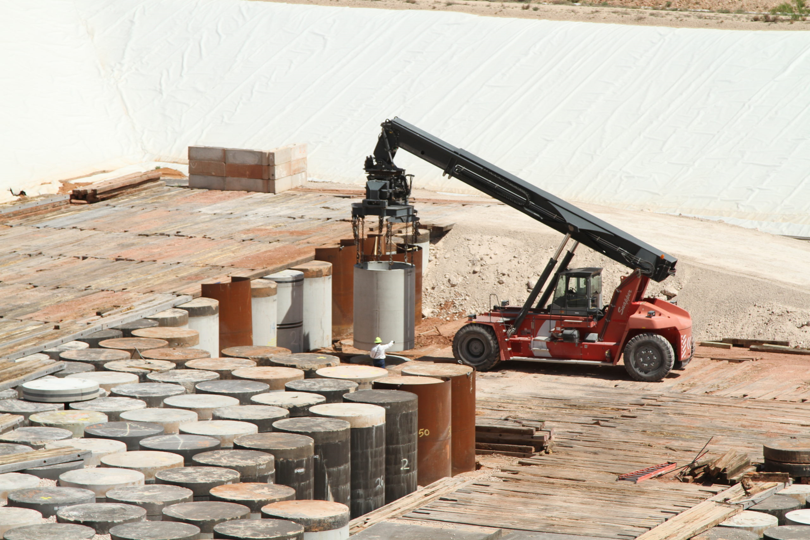
Waste Disposal in the CWF
24

Slide 25
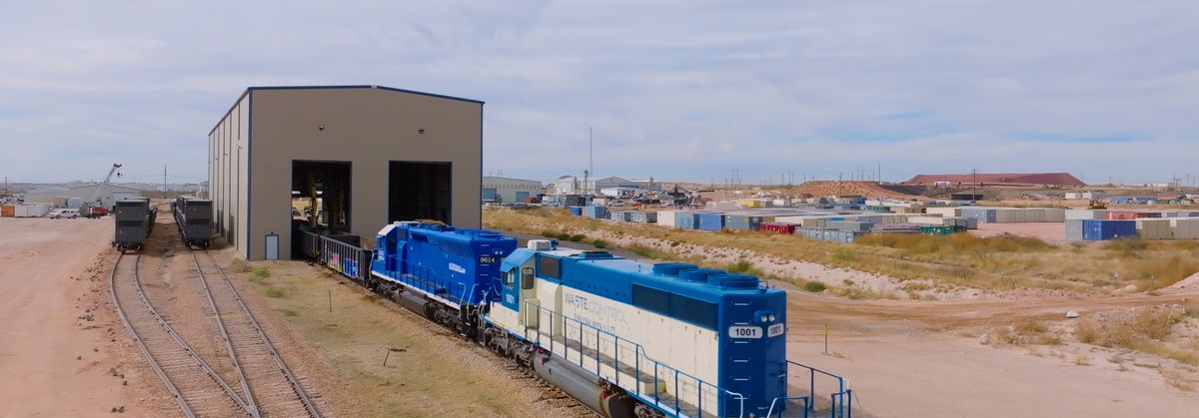
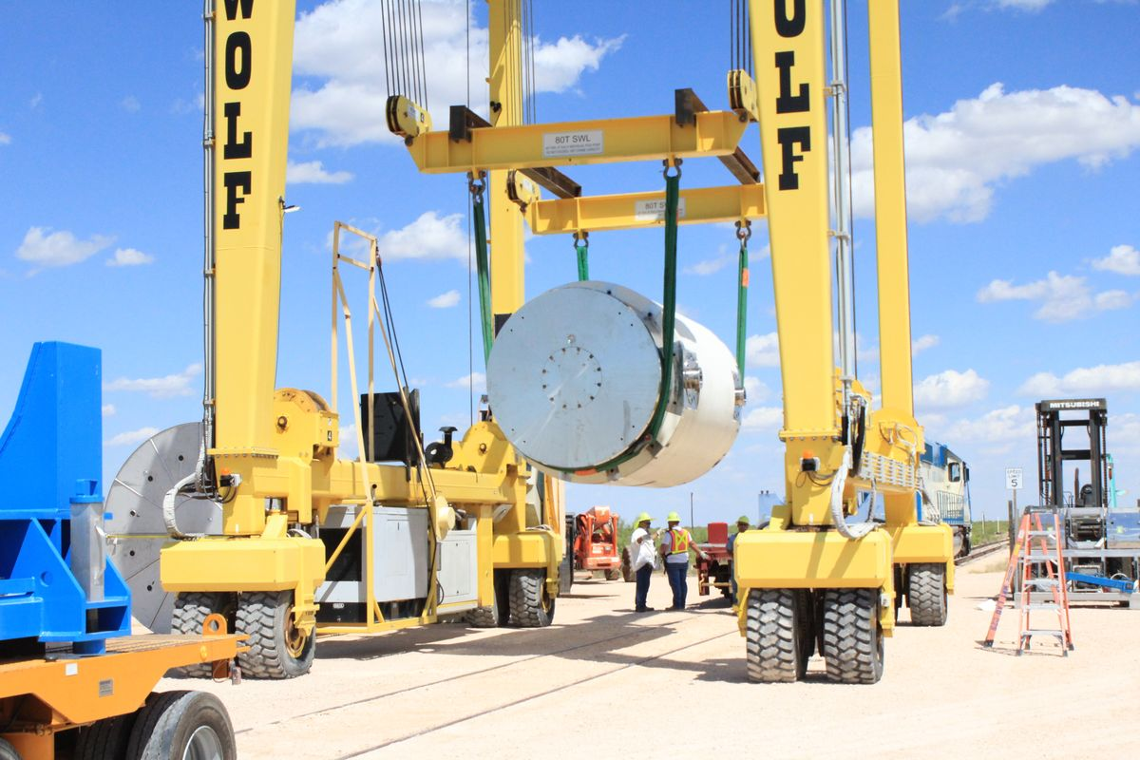

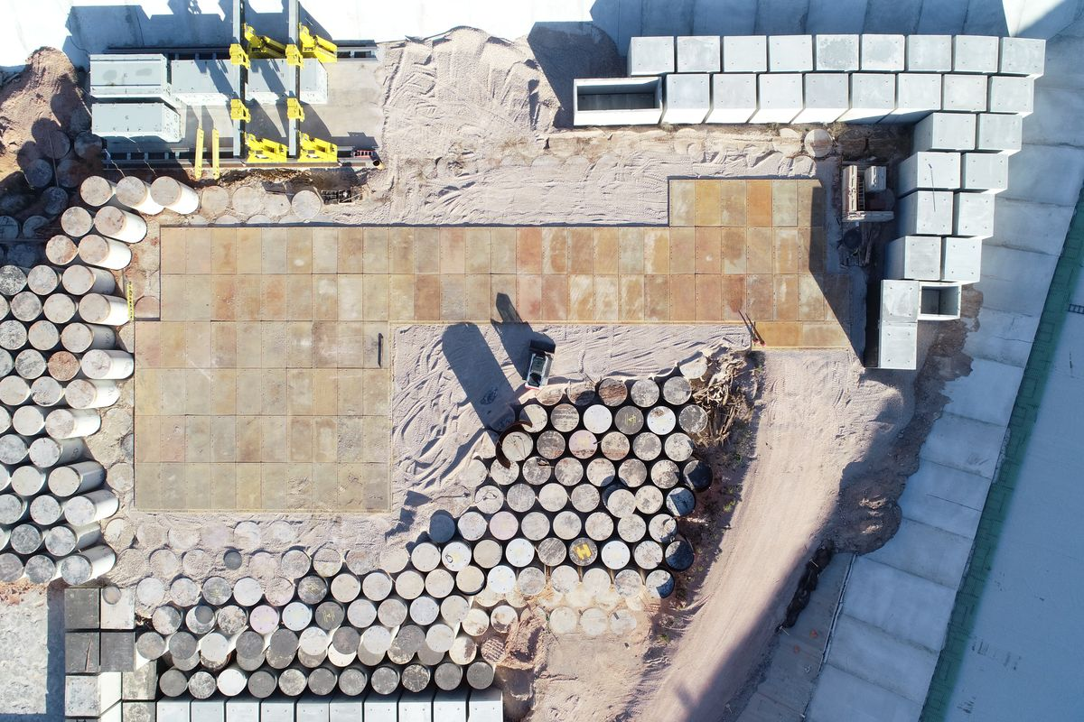
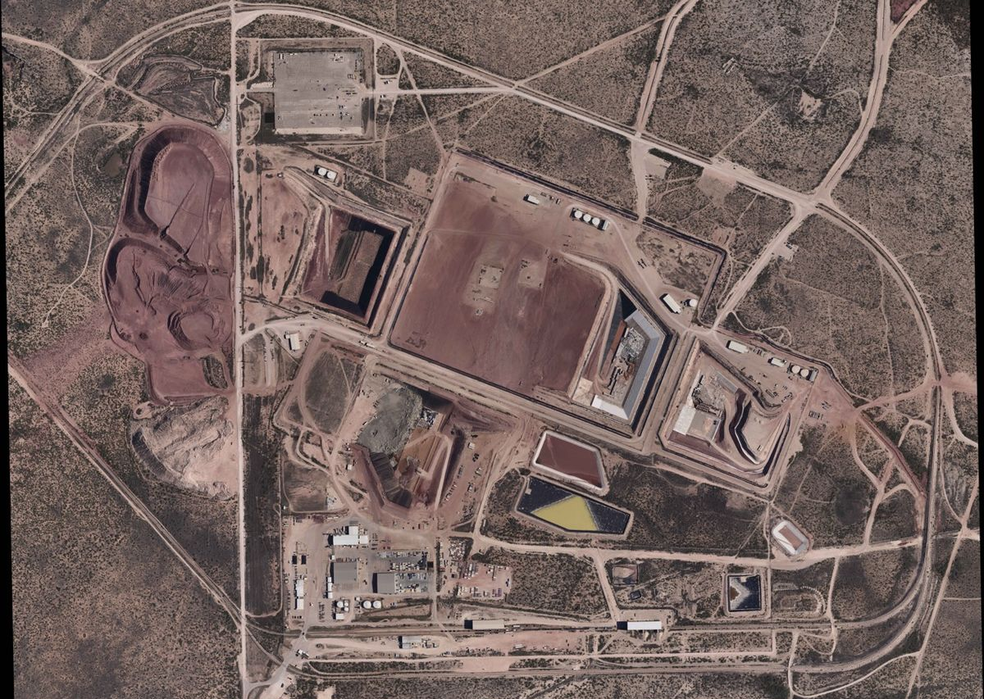
Questions?
Contact:
Chris Shaw
Director of Technical Services
cshaw@wcstexas.com
25

